Slide 1


BIOREMEDIATION
GROUP MEMBERS
ADITYA PHUKAN(20802002)
HARSHIT BORA(20802003)
PRIYANSHU GUPTA(20802011)
NIRMAN BATRA(20802014)

Slide 2
Definitions
Bioremediation is a branch of biotechnology that employs the use of living organisms, like microbes and bacteria, in the removal of contaminants, pollutants, and toxins from soil, water, and other environments.
Bioremediation is used to clean up oil spills or contaminated groundwater.
Bioremediation may be done "in situ"–at the site of the contamination–or "ex situ"–away from the site.
Bioremediation uses biological agents, mainly microorganisms i.e. yeast, fungi or bacteria to clean up contaminated soil and water.
This technology relies on promoting the growth of specific micro flora or microbial consortia that are indigenous to the contaminated sites that are able to perform desired activities

Slide 3
Bioremediation is a triple-corners process:
Solid
Inorganic
Organic
Pollutants
Liquid
Gas
Environments
Organisms
Soil
Microorganisms
Water
Plants
Air
Enzymes

Slide 4
Bioremediation related topics
Environments
Organisms
Pollutants
Phytoremediation
Bioremediation of metals polluted environment
Bioremediation
Enzymes immobilization
Cells immobilization
Bioremediation techniques
Biosurfactants
Enzymes separation and identification

Slide 5
Stages of a biodegradation study
1- Isolation of the microorganism
2- Purification of the obtained isolates
3- Identification of the microbial isolate
4- Optimization of the biodegradation conditions
5- Determination of the biodegradation efficiency
6- Identification of the biodegradation products.
7- Cell or enzyme immobilization.
8- Enzyme identification.

Slide 6
Cells and Enzymes immobilization:
Immobilized enzymes (or cells) is defined as the enzyme that physically or chemically confined in defined materials with retention of its catalytic activity.
The immobilization methods
1- Carrier-binding methods.
2- Cross-linking methods.
3- Entrapping methods.
1) Covalent binding methods
1- lattice method.
2- Ionic binding methods.
2- Microcapsule.
3- Physical adsorption.
3- Membrane.
4- Bio-specific binding methods.
4- Reversed micelle.

Slide 7
Materials used in the Carrier-binding methods
1- Polysaccharides: cellulose, dextran and agarose derivatives.
2- Proteins: gelatin, albumin.
3- Synthetic polymers: Polystyrene derivatives, ion exchange resins, polyurethane.
4- Inorganic materials: glass, sand, ceramic and magnetite.

Slide 8
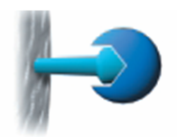
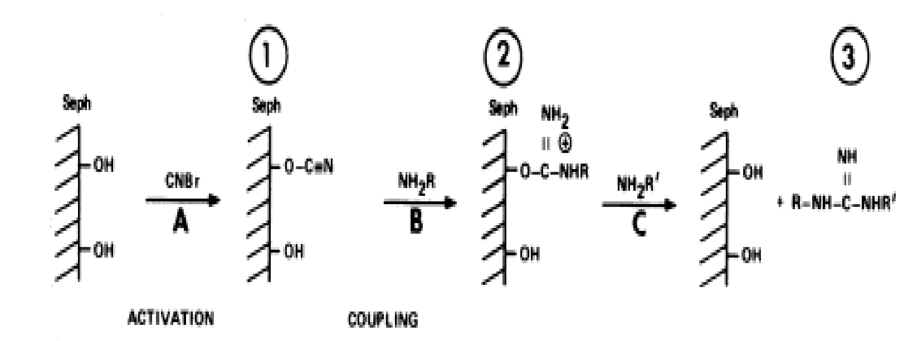
1) Covalent binding methods include:
a) Cyanogen Bromide method (CNBr).
b) Acid-azide derivative method
c) Condensing reagent methods
d) Diazo coupling methods
e) Alkylation methods.
Figure1: Steps of CNBr enzyme immobilization method

Slide 9
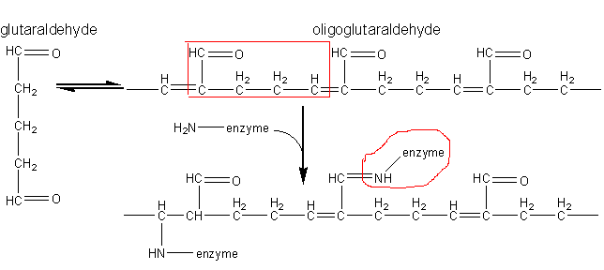
B- Cross-linking methods:
By cross-linking of the enzyme molecules by reacting with glutaraldehyde.
A cross-link is a bond that links one polymer chain to another.

Slide 10
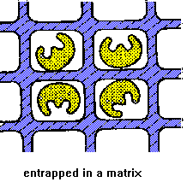
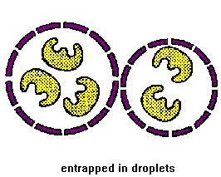
3- Materials used in the entrapping methods
a) Lattice type:
polyacrylamide,
calcium algenate,
polyvinylalcohol polymers.
b) Microcapsule type:
Interfacial Polymerization Method.
Liquid drying method.

Slide 11
Phytoremediation
Phytoremediation is use of plants for accumulation, removal or conversion of pollutants.
Phytoremediation
Phytostabilization
Phytovolatilization
Phytostimulation
Phytotransformation
Phytoextraction

Slide 12
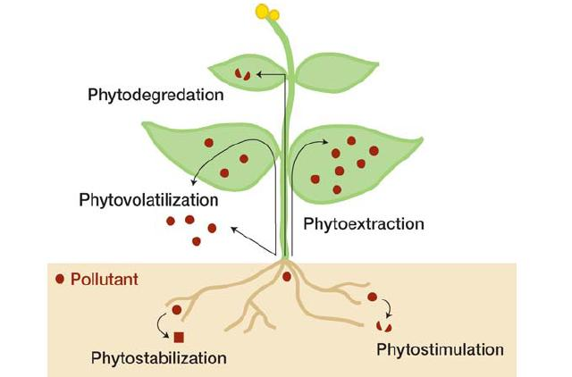

Slide 13
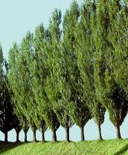
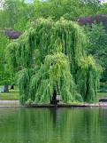
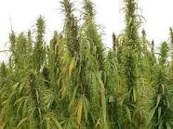
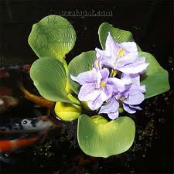
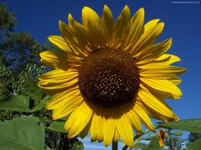
Approximately 400 plant species have been classified as hyperaccumulators of heavy metals, such as grasses, sunflower, corn, hemp, flax, alfalfa, tobacco, willow, Indian mustard, poplar, water hyacinth, etc.

Slide 14
The root exudates of these plants play an important role in phytoremediation as it activate the surrounded microorganisms.
Genetic engineering are used as in case of BT protein or insect pheromones producing plants to reduce the use of pesticides.

Slide 15
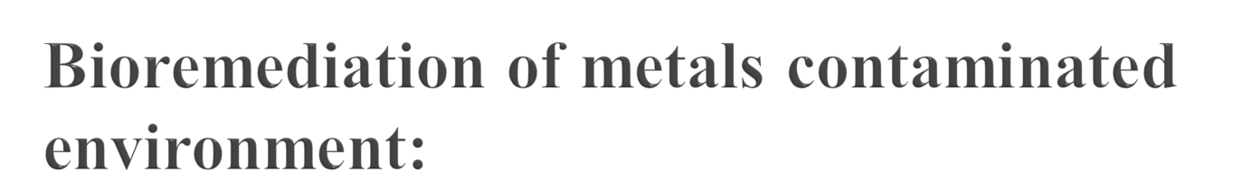
Metals bioremediation mechanisms
Metal immobilization
Solubilization
(Bioleaching)
- Organic acids.
- Siderophores.
- Root exudates.
Complexation
(Bioaccomulation)
(Biosorption)
Precipitation
- H₂S producing bacteria
- Siderophores.
- Metal reduction.
- Exopolysaccharide.
- Lipoproteins.

Slide 16

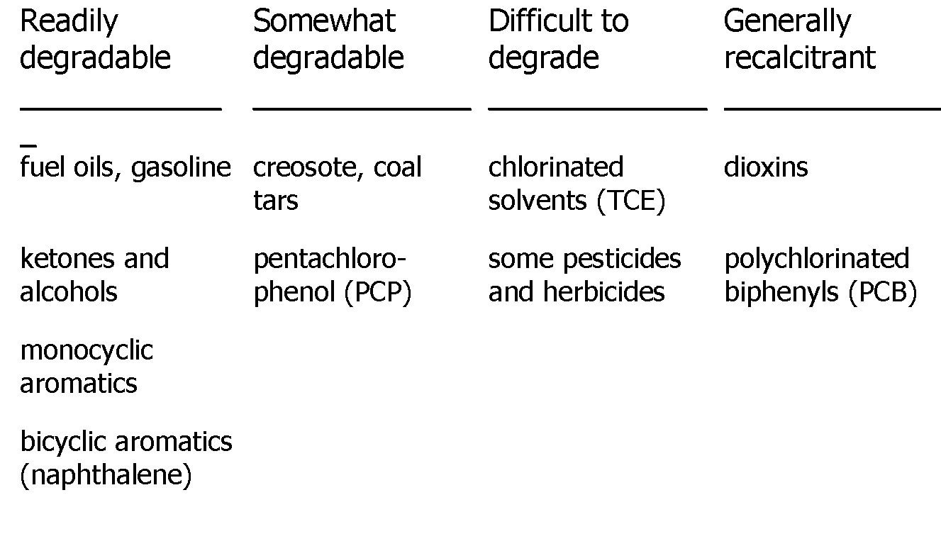
Contaminants Potentially Amenable to Bioremediation ____________________________________________

Slide 17
Biosurfactants
The biosurfactants are chemical compounds characterized by hydrophobic and hydrophilic (non-polar and polar) regions in one molecule (amphipathic molecules).
Biosurfactants from bacteria, cyanobacteria, fungi and yeast are classified into:
Glycolipids.
Lipopeptides.
Phospholipids.
Glycoproteins.
Polymeric biosurfactants.
Notes:
17

Slide 18
Physiological roles of biosurfactants:
1- Increase the availability of hydrophobic compounds
2- Nutrient storage molecules.
3- Save the microbial cells from toxic substances.
4- Efflux of harmful compounds.
5- Extracellular and intracellular interactions such as quorum sensing and biofilm.

Slide 19
Biosurfactant applications in bioremediation:
The microbe may access a poorly water-soluble substrate that has been “pseudosolubilized” by the biosurfactant.
Reduce the adsorption of the non-polar pollutants to the surface of soil particles.

Slide 20
Bioremediation techniques:
(1) In-situ (without excavation).
(2) Ex-situ (with excavation).
Only ex-situ processes allow an efficient optimization of incubation parameters (biostimulation), including:
pH,
Aeration,
Agitation,
Moistening
nutrients,
solvents or surfactants.
In addition to addition of microorganisms (bioaugmentation).

Slide 21
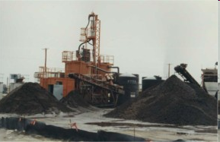
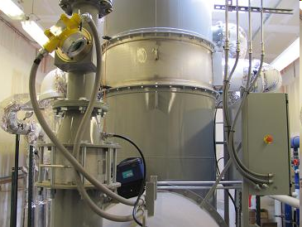
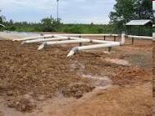
The ex-situ technique includes:
1- Bioslurry reactor.
2- Biopile.
3- landfarming
Biopile.
Bioslurry reactor.
Biopile.

Slide 22
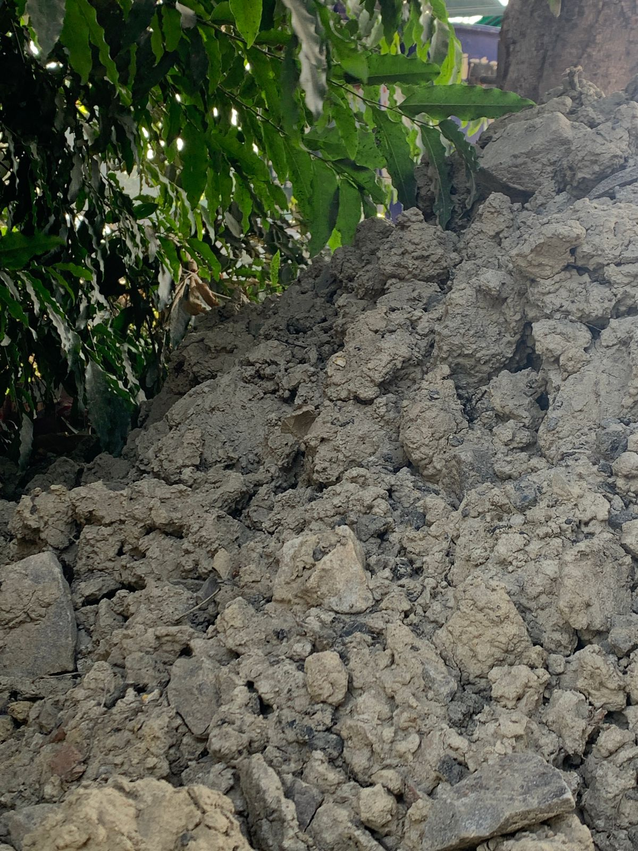
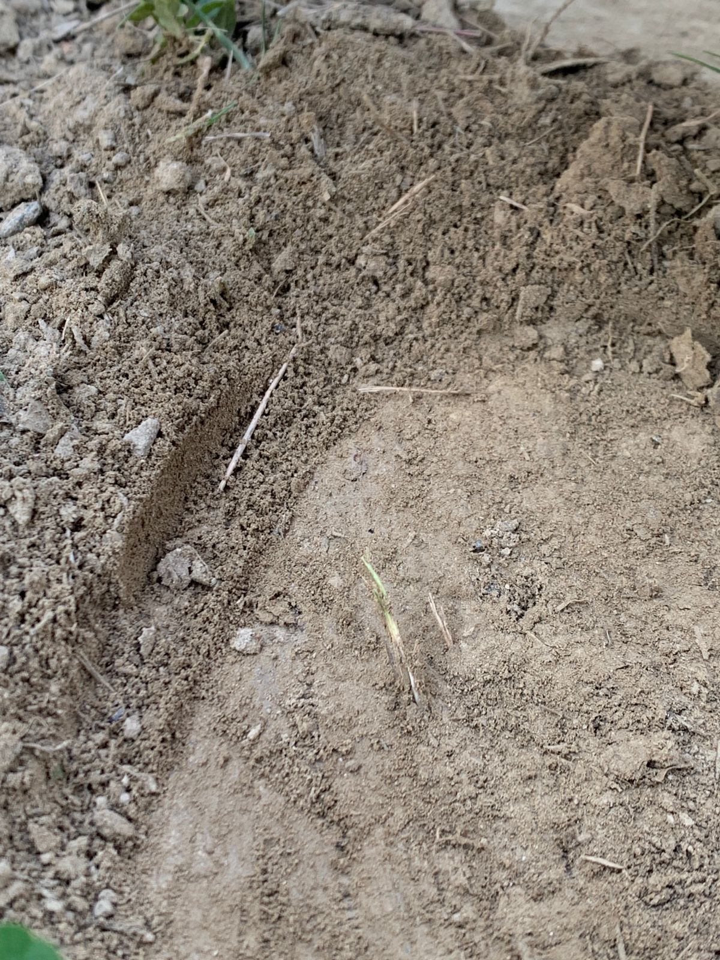
FIELD WORK

Slide 23
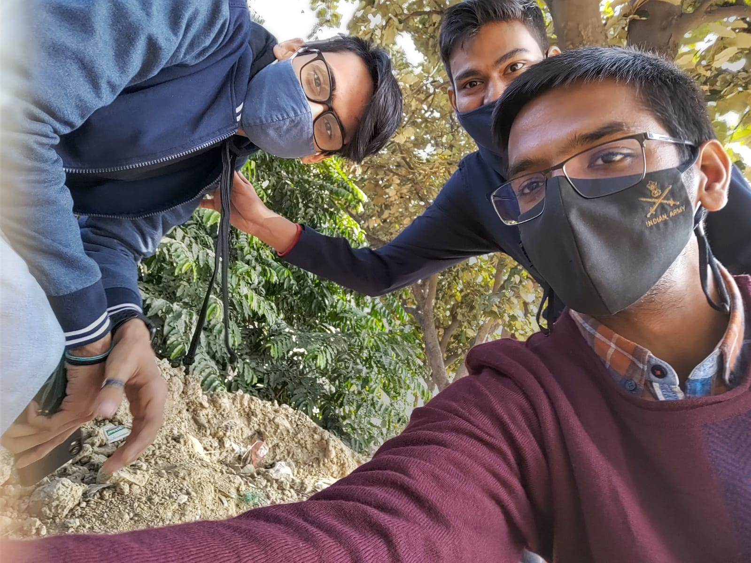
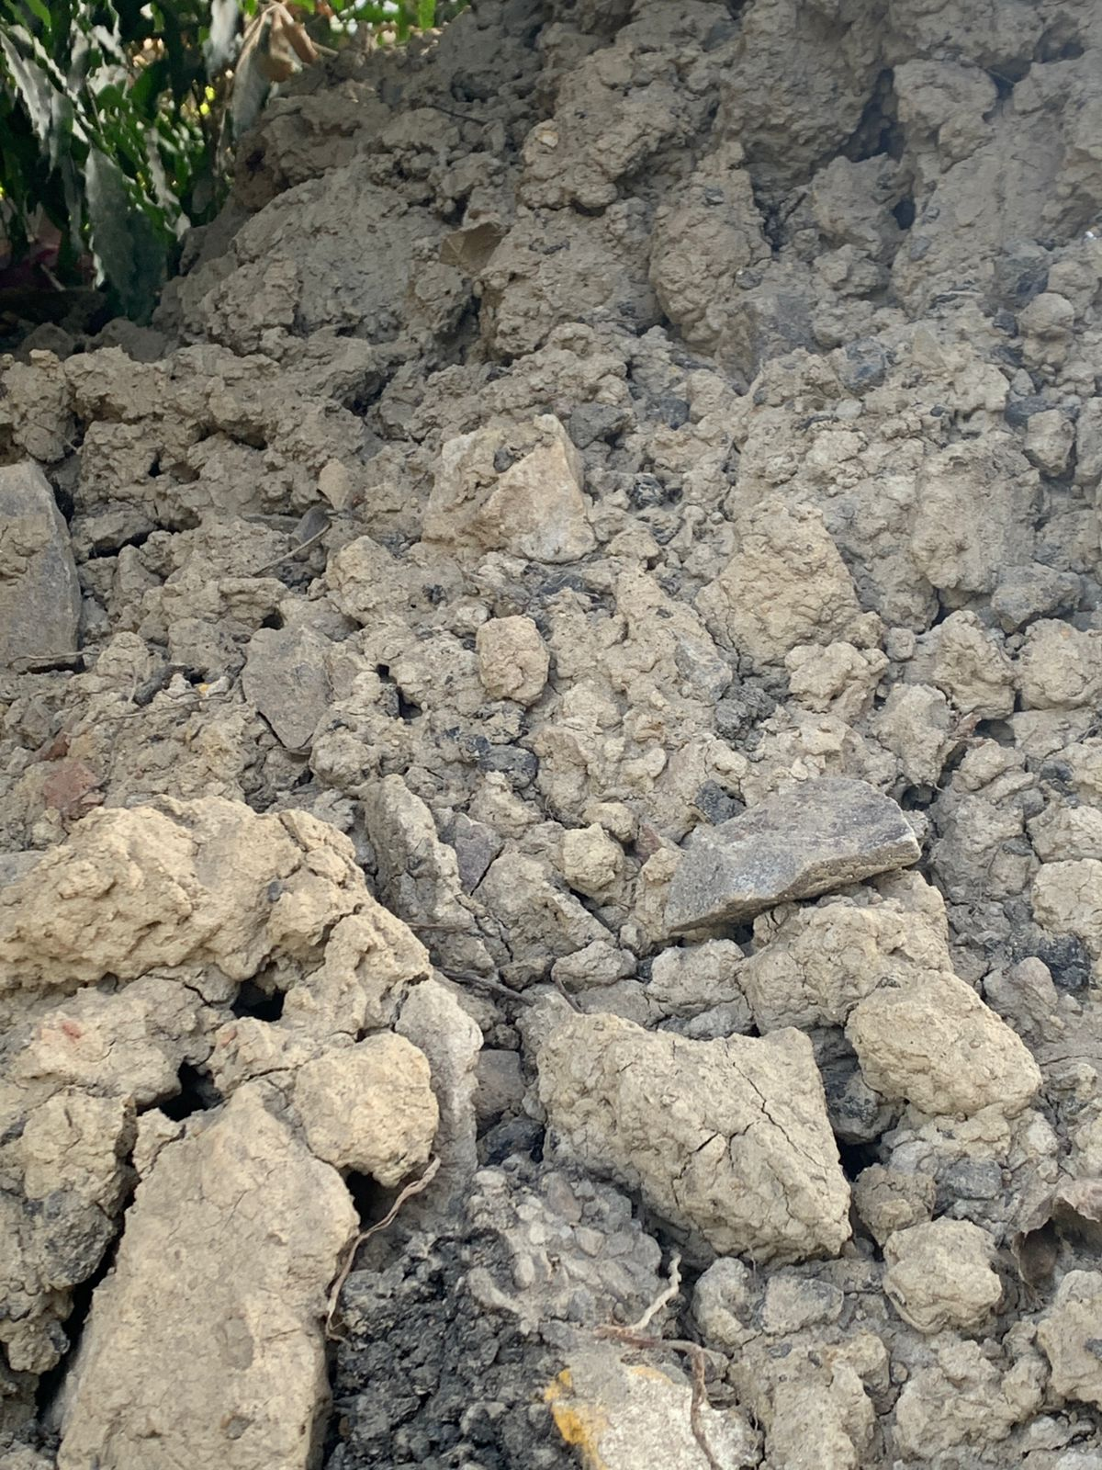
FIELD WORK

Slide 24

Bioremediation provides a technique for cleaning up pollution by enhancing the natural biodegradation processes. So by developing an understanding of microbial communities and their response to the natural environment and pollutants, expanding the knowledge of the genetics of the microbes to increase capabilities to degrade pollutants, conducting field trials of new bioremediation techniques which are cost effective, and dedicating sites which are set aside for long term research purpose, these opportunities offer potential for significant advances. There is no doubt that bioremediation is in the process of paving a way to greener pastures. Regardless of which aspect of bioremediation that is used, this technology offers an efficient and cost effective way to treat contaminated ground water and soil. Its advantages generally outweigh the disadvantages, which is evident by the number of sites that choose to use this technology and its increasing popularity. Once again thanks to the bioremediation technology to clean up the polluted environment and therefore may be used as management tool.

Slide 25


